Slide 1
TITLE : Cyclistic Bike-share Analysis for Targeted Casual-users marketing
Name : Tamojit Roy
Reg. No : 19BCE1156
Guide : Dr. A Sheik Abdullah
Review-1 : Capstone Project (Final Year) – B.Tech CSE [2019-23]

Slide 2
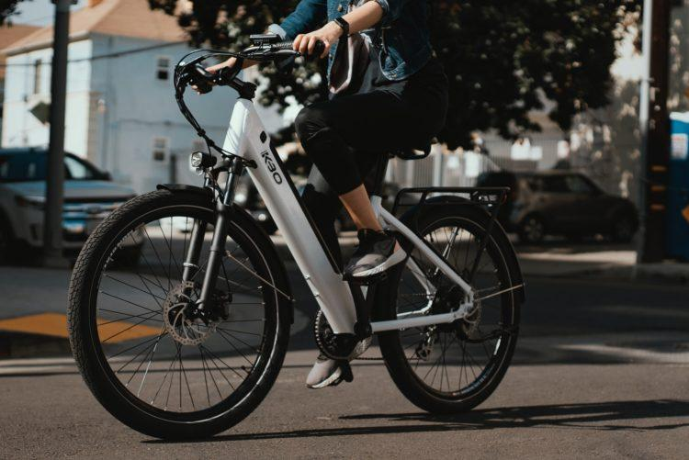
OUTLINE
This research work will mainly revolve around understanding how annual members and casual riders use cyclistic bikes differently. The comparison along with other tasks will later be used to design marketing strategies aimed at converting casual riders to annual members.

Slide 3
I. INTRODUCTION

Slide 4
A. STATEMENT OF PROBLEM
Understanding how subscribers of Divvy bike-sharing trips and the bike-sharing service availing only-customers use the bikes differently for commute purposes, recreational purposes, schooling, marketing, etc. and analyzing the multifarious shadow factors which influence both the user categories in opting for the type of service which they show their inclination towards.
This comparison along with other tasks will later be used to design marketing strategies aimed at converting the customers of Divvy bike-sharing trips to the long-term subscribers of the bike-sharing service.

Slide 5
B. SIGNIFICANCE OF STUDY
Although many researches on bike-share systems have been conducted earlier, on different aspects of the commute methodology utilized in it, even on few broad scenarios as well, case studies focusing upon a particular region or area in which many different factors have been researched upon and analyzed still are not sufficient. Since, it is a broad topic, generalized results/conclusions presented in some of the researches ain't never sufficient for applying to all the regions of the globe.
The BSS Industry no-doubt has huge potential in the future. The below mentioned points prove and illustrate the same:
1. It is expected to grow at a robust 5.02 percent CAGR.
2. People all over the world are becoming more and more health-conscious
3. Awareness on cardiovascular fitness, muscle power and flexibility, better-joined mobility, reduced stress levels, increased posture and coordination, bones strengthened and reduced levels of body fat.

Slide 6
CONTINUED.
4. Increased demand for bicycles across India, driven mostly by congestion, urbanization, and sustainability.
5. The world cycling market, with the demand for traditional and electric cycles as never before, is predicted to be Rs. 4.4 lakh this year's crore.
6. Infrastructure rollout by various governments to support bicycle commuting, shortage of parking space, increasing traffic congestion, and preference for cycles as a relaxing mode of exercise.
7. Impact of COVID-19: Bikes cover short to medium distances due to health safety issues, people in metropolitan areas cycle because owing to the physical differences in standard, they are not able to frequent the gym.
8. Indian bicycles represent a value of 1% from the world market and 15% by volume of the market.

Slide 7

PICTURES SHOWING SIGNIFICANCES

Slide 8
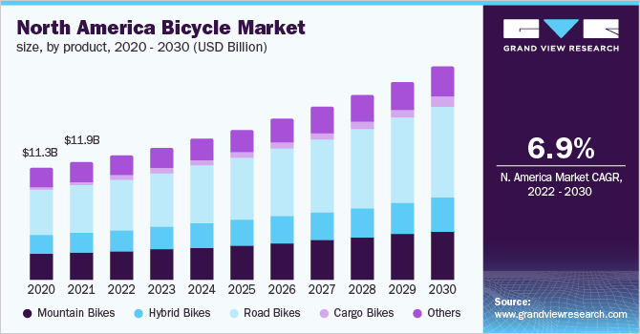

Slide 9
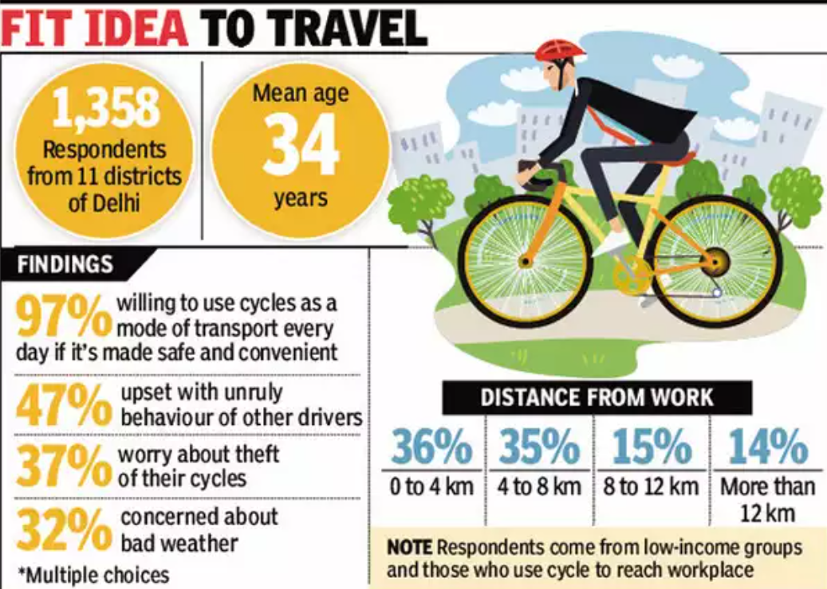

Slide 10
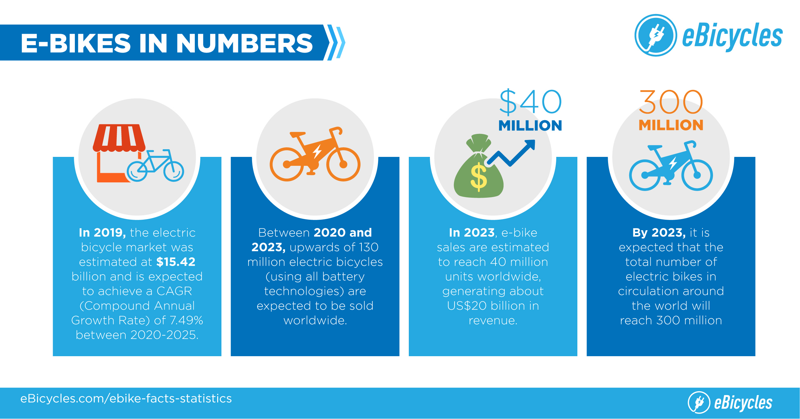

Slide 11
II. LITERATURE REVIEW

Slide 12

THEMES - OVERVIEW
S.No | Paper Title | Summary | Algorithms Used | Pros/Cons
[1] | Md Doulotuzzaman Xames, Jannatul Shefa, Ferdous Sarwar, "Bicycle industry as a post‑pandemic green recovery driver in an emerging economy: a SWOT analysis", Springer-Verlag GmbH Germany, part of Springer Nature 2022 (Environmental Science and Pollution Research), July 2022. | This paper deals with analyzing and examining the various factors, which portray the bicycle-industry as a potent industry which can lead to the green recovery and sustainable development of economy and environment in Bangladesh. The authors performed a SWOT analysis after collecting and analyzing information with regards to the bicycle industry in the south-Asian developing economy from many research publications, and by interviewing industry experts, government officials and university professors and finally a joint discussion by all the experts. Based on the findings in which both internal factors (strengths and weaknesses) as well as external factors (opportunities and threats) were taken into consideration, they came up with an internal factor evaluation matrix (IFEM) to find out that the bicycling industry in Bangladesh has enormous potential, given that some reforms be conducted upon the same with a view towards reducing carbon-emissions and decarbonizing the commute sector by facilitating green investment in bicycling as a non-motorized transport (NMT) option to reduce GHG emissions in the post-pandemic settings. Suggested potential strategies to facilitate the adoption of bicycles as a resilient and sustainable transport option such as by developing local manufacturing capability, dedicated infrastructure, reducing import duties, attracting FDIs, eliminating gender differences, etc., were also mentioned. | SWOT, IFEM, EFEM. | Pros: 1. Can be used for making strategic planning decisions. Cons: 1. Data collected for analysis can never be sufficient and reliable.
[2] | Weiwei Jiang, "Bike sharing usage prediction with deep learning: a survey", Springer-Verlag London Ltd., part of Springer Nature 2022, Neural Computing and Applications (2022) 34:15369–15385, June 2022. | The analysis of the pattern of bike-sharing in a region plays the most significant role in predicting the bike usage in any particular region. The authors in this paper, have provided a comprehensive review of bike-sharing usage prediction with many invaluable approaches to predict the bike-sharing usage pattern with deep learning. Following a set of procedures of the following modules: data aggregation to build the prediction input-features and targets, defining 3 data formats (time-series format, grid format and graph format), addressing 3 types of prediction problems (time series-input prediction, graph-input prediction and grid-input prediction), quantifying the prediction error using different evaluation metrics, and finally some prediction challenges (complex spatial dependencies and complex temporal dependencies) and prediction models like FFNN, LSTM, RNN, GNN, GRU, MLP, SVR, etc., were illustrated with a different section for each type of model was mentioned for both docked and dock-less bike-sharing systems. Finally, application scenarios within the bike-sharing systems and beyond were brought up followed by the challenges and the development directions in the research paper. More open datasets, various applications based on bike usage prediction and potential research directions were summarized to encourage future research. | Fuzzy c-means clustering, distance-based clustering, RMSE, MAE, MAPE, SMAPE, RNN, CNN, GCN, GAT. | Pros: 1. Good prediction accuracy when unexpected events are kept out of the bay. Cons: 1. Unexpected variability of external factors.
[3] | Suzana Regina Moro, Paulo Augusto Cauchick-Miguel, "An Analysis of a Bike-Sharing System from a Business Model Perspective", Brazilian Journal of Operations & Production Management, Vol. 19, No. 2, e20221400, 2022, ISSN 2237-8960 (Online), June 2022. | A vision of developing a sustainable bike-sharing system as viewed a PSS (product-service system) was expressed by the authors in this research paper. Although, it was initially developed considering a single focal-company, restricted to a particular region (southern region of developing country, Brazil) only, the authors emphasized the significance of their research-work claiming that it was the first one to be done keeping in mind the scenario of a developing country. The design of the system-model organized in 4 stages: (i) value proposition, (ii) value configuration, (iii) value delivery and (iv) value capture was introduced. Although, the strategy doesn't hold the providers of the service as the manufacturers themselves, the business-model analyzed was a use-oriented in the context of shared mobility. By conducting face-to-face interviews with those involved in developing the business model, a research protocol was developed. The authors expressed that the PSS business model analyzed by them could represent significant contributions to improve micro-mobility. | PSS. | Pros: 1. PSS solution offered. Cons: 1. Single study conducted only considering the focal company so restricting the external validity.

Slide 13
CONTD.
S.No | Paper Title | Summary | Algorithms Used | Pros/Cons
[4] | Yuanyuan Guo, Linchuan Yang, Yang Chen, "Bike Share Usage and the Built Environment: A Review", Frontiers in Public Health (www.frontiersin.org), Volume 10, Article 848169, February 2022. | This paper entirely deals with understanding, analyzing and illustrating the multiple modes and forms of relationships between build environment (i.e., land-use, transportation system and urban design) and bike-share usage. Quite a many variances between the build environment and bike-usage were stated and described with some outliers in notable cases. Variance in relationship in the build environment across different mobility patterns, docked and dockless bike-share patterns, w.r.t. trip purpose, between arrival and departure patterns, based upon the day of week, etc. and the bike-share usage were elaborated. The paper concluded with a brief summary of the major findings of the authors and them encouraging the recommendations for the future research works. | Self-devised algorithm for literature search and selection process. | Pros: 1. Shown that effects of certain built environment factors on bike share usage were sometimes inconsistent among the selected empirical studies. Cons: 1. Requires a more comprehensive approach for better insights.
[5] | Songhua Hu, Mingyang Chen, Yuan Jiang, Wei Sun, Chenfeng Xiong, "Examining factors associated with bike-and-ride (BnR) activities around metro stations in large-scale dockless bikesharing systems", Journal of Transport Geography 98 (2022) 103271, Elsevier Ltd., December 2021. | The study attempted to examine the associations of BnR (bike and ride) activities with metro area w.r.t. DBS (dockless bike sharing) systems, in the city of Shanghai, China. The study signalled that BnR behaviors were affected by features like station features, land use, socio-demographics, roadway designs, transportation facilities, etc. Mainly four metrics were employed in the entire study to understand BnR behaviors from the perspective of different participators viz. local govt., DBS users, etc. The metrics were BnR trip count, shared-bike utilization rate, metro catchment area and BnR rate, for the assessment of BnR performance. The generalized additive model (GAM) was utilized to build statistical inference. Several statistical issues such as over-dispersion, skewness and spatial autocorrelation were addressed while modelling DBS usage. The spatial distribution of the 4 metrics suggested that shared bikes were oversupplied in the city center while undersupplied in the suburb. Based on other things, various other conclusions were drawn for comprehensive analysis. | Negative binomial regression, multilevel mixed model, ARMA, GAMs. | Pros: 1. Gave a comprehensive statistical framework to evaluate BnR performance in DBSmetro systems, estimate BnR demand of riding shared bikes, support shared bike relocation, and eventually help promote the efficiency and attractiveness of using DBS as a feeder mode of transit. Cons: 1. Variables used are correlational and can’t prove causality, 2. All analyses were deduced at an aggregate level in the absence of available information at the individual. 3. Data represents behavior of only DBS users.
[6] | Hanning Song, Gaofeng Yin, Xihong Wan, Min Guo, Zhancai Xie, Jiafeng Gu, "Increasing Bike-Sharing Users’ Willingness to Pay — A Study of China Based on Perceived Value Theory and Structural Equation Model", Frontiers in Psychology (www.frontiersin.org), Volume 12 | Article 747462, January 2022. | In this research paper, the authors sought to investigate the correlation of the various factors of the perceived value upon the users willingness to pay for bike-sharing services in the first-tier and second-tier cities of China. A structural analysis was also conducted to validate the findings and visualize the significance of the different factors as variables. The paper analyzed the direct and indirect factors that affect bike-sharing users' willingness to pay. Based upon the findings, the authors concluded that, perceived usefullness and perceived ease-of-use have positive impact on perceived value; and perceived trust, perceived value, individual paying consciousness and environmental protection have positive impact on perceived value; the users' word-of-mouth and perceived entertainment have no significance; and finally perceived cost and perceived risk have negative impact on perceived value. | Scale Design on PV, PU, PE, PEU, PC, PR, IPC, WOM, PT, EP, WTP; Reliability Analysis; Validity Analysis; Confirmatory Factor Analysis and Correction; Model Building. | Pros: 1. Assess bike-sharing users consumptive decisions. 2. Assess users’ willingness to pay. Cons: 1. Model could have been more accurate and there is scope of improvement.

Slide 14
CONTD.
S.No | Paper Title | Summary | Algorithms Used | Pros/Cons
[7] | Xiaonan Zhang, Jianjun Wang, Xueqin Long, Weijia Li, "Understanding the intention to use bike-sharing system: A case study in Xi’an, China", PLoS ONE 16(12): e0258790, December 2021. | This paper investigates the various factors which make the bike-sharing services to be retained by the users, and not just be opted by them in the first place. For data collection purposes, questionnaires were collected through both online and offline survey. A total of 650 questionnaires were collected, including 500 field surveys and 150 online questionnaires, resulting in 622 valid questionnaires. The authors introduced the related concepts of participation in purchasing decisions, customer engagement, and customer-perceived value, and uses a structural equation model to identify the interaction and influence mechanisms between the three variables and usage intent. It not only extends the scope of consumer behavior theory, but also provides management and marketing strategies for bike-sharing companies. | SEM, Reliability & Validity, Direct effect test, Intermediary effect test. | Pros: 1. Showed that all influencing factors were significantly positively associated with usage intention. Cons: 1. Limited sample size. 2. Some factors like residents’ travel characteristics, weather, etc. not considered.
[8] | Puneeth B. R., Nethravathi P. S., "Bicycle Industry in India and its Challenges – A Case Study", International Journal of Case Studies in Business, IT, and Education (IJCSBE), 5(2), 62-74, ISSN: 2581-6942, Vol. 5, No. 2, August 2021. | Through the paper, the authors tried to analyze and discuss the current bicycle market scenario in India and where the developing country presently makes its stand in the world when it comes to manufacturing, exporting and ranking in terms of bikes' usage and procurement of raw materials. The objectives which they proposed in the research papers include, gaining knowledge about India's cycle industry, learning about the industry's development, comparative analysis between sales and production, study of the future growth and analysis of the industry, the bicycle industry's contribution in international economic development, research on how latest gadgets can be added in bikes, understanding CORONA's impact on the Indian cycle industry, and finally, a SWOT analysis to aggregate the facts and figures for recommendation purposes favoring the success of the Indian cycle manufacturing industry in the future. After collecting the data from various sources, viz., journal, published papers, archived newspaper articles, official bicycle industry websites, and other ventures, the authors discussed various aspects: the growth of bicycle industry in India; future analysis of bicycle industry in India; major competitors of India in the industry; the contribution of bicycle industry in international economy development; the research and development centre for bicycle in India; the analysis highlighting the strengths, weaknesses, opportunities and threats of the Indian bicycle industry; CSR activities; COVID-19 impact on the Indian bicycle industry. Based upon the aforementioned, they provided their recommendations and concluded with areas for future development of the industry. | Data Collection, SWOT Analysis. | Pros: 1. Several enhancement suggestions provided based on analysis. Cons: 1. Very theoretical study and very less or no numerical computation used.
[9] | Vitória Albuquerque, Miguel Sales Dias, Fernando Bacao, "Machine Learning Approaches to Bike-Sharing Systems: A Systematic Literature Review", International Journal of Geo-Information, ISPRS Int. J. Geo-Inf. 2021, 10, 62, February 2021. | The paper provides a systematic literature review (SLR) of various research papers specializing in exploring and analyzing the multifarious machine learning approaches applies to bike-sharing systems (BSS). Based on a preferred reporting items for systematic reviews and meta-analyses (PRISMA) methodology, that consists of a checklist and a flow diagram, the systematic literature survey was performed. A four-phased flow diagram consisting of the following phases: identification, screening, eligibility, was aimed to describe and understand the items of the different sections. The authors framed a process workflow to understand all the stages of the study, viz., keyword identification and search, repositories, bibliometric analysis, etc. The open source tool VOSviewer, was used as the bibliometric research tool for network analysis. The tool helped to to identify the main keywords, authors, co-authors and their respective relations, within the SLR data set, for quantitative analysis. Many graphs were created for each of the sections of interest, by the authors in order to bring out reasonable insights from the study. Based on the findings, the authors asserted that the two main problems addressed by the machine learning techniques in the context of bike-share systems are clustering (classification) and prediction. Three clustering algorithms, viz., hierarchical-clustering, community-detection-clustering and k-means-clustering are more commonly used. The authors additionally also discussed the various research and study limitations in their whole study. The study tried to raise some recommendations for the future work within the overarching theme of machine learning techniques applied to BSSs. | PRISMA, keyword identification and search, bibliometric analysis, keyword occurence analysis, title and abstract text occurrence analysis. | Pros: 1. Outlined and identified the main ML techniques contribution to BSSs in urban mobility. Cons: 1. Sufficient case studies and different features to validate and improve future modelling strategies not provided.

Slide 15
CONTD.
S.No | Paper Title | Summary | Algorithms Used | Pros/Cons
[10] | Anil Jain, Nirmala Joshi, Anand J Mayee, "Factors motivating buying behavior of female two wheeler users in the district of Palghar", Journal of Management Research and Analysis, October-December, 2020;7(4):154-158, December 2020. | The research paper examines the various factors influencing the buying of two wheeler vehicles by the females in Palghar, distant suburb of Mumbai city. For collecting the data, the authors used structured questionnaires (primary data) and websites, journals, research articles and news reports (secondary data). For their research purposes, the authors collected data samples from a total of 150 respondents. Random sampling was used for the collection of primary data. The authors specified a set of hypothesis and performed a data analysis report, which put light upon the various aspects of the female buying behavior and more, viz., popularity of brands among female riders, use of internet in buying decision, awareness of celebrity endorsement, mode of purchasing the vehicle, etc. They concluded that necessity was the most influential factor affecting the buying decision of female two wheeler users. Based on the calculations, as the Chi square value was significantly high, it made them to accept the alternate hypothesis which they set. Other conclusion drawn were, celebrity endorsement had no significant impact on the buying behavior and most of the women use the two-wheelers jointly with other family members. | Some data analysis techniques. | Pros: 1. Some insights provided. Cons: 1. Limited data.
[11] | S. Diwakar Raj, Dr. N. Kannan, "Factors Influencing Purchase of Two Wheeler - A Study with Reference to Chennai City", International Journal of Management, 11(12), 2020, pp 2977-2982, ISSN Print: 0976-6502 and ISSN Online: 0976-6510, December 2020. | Information from survey of local respondents and other sources were used for studying the factors which influences the purchase of two wheeler modes of transport in the city of Chennai. Both primary and secondary data were involved in the study by the authors. The primary data was collected from the owners of two-wheelers using questionnaires. The secondary data was sourced from published reports, records, books, Journals, bulletins, magazines, internet and newspapers. About 100 respondents were selected for collecting the primary data with suitable sampling techniques. Some of the objectives put forward by the authors included: to analyze the age of the respondents, to identify the type of media created awareness among the consumers, to analyze the factors influencing the purchase of two-wheeler, and to know the expectation of consumers in the purchase of two-wheeler. This was followed by the analysis and implementation. The authors concluded the research paper with suggestions and conclusion. | Data collection, analysis and interpretation. | Pros: 1. Data collected directly from real-valued opinion of people. Cons: 1. Limited to only a very particular region (not wide-scale). 2. Simplistic data analysis and discussion overview provided.
[12] | Gyugeun Yoon, Joseph Y.J. Chow, "Unlimited-ride bike-share pass pricing revenue management for casual riders using only public data", International Journal of Transportation Science and Technology 9 (2020) 159–169, January 2020. | The authors scrutinized revenue management strategies for unlimited usage bike-share scenarios in their research paper. Citi Bike public data has been used by the authors for the overall analysis. Summarization of the basic data for understanding the behavioral patterns of the casual users and the number of trips that casual users take was estimated for relating between the two, because such data was not publicly available. The parameters of these distributions were derived from sample means and standard deviations using linear regression of daily short-term ticket sales and occasional passenger numbers. A path choice model was built using variables resampled from the fitted distribution by the bootstrap method. The multinomial logit model was used because it could represent not only individual vote probabilities but also aggregated market shares. As a result, the price combination of the two plans was optimized to maximize revenue based on estimated model output, and the impact on consumer surplus was quantified. | Linear regression, multinomial logit model (MNL). | Pros: 1. Serves as a case study in MaaS revenue management. 2. Provides some very interesting insights on what can and cannot be done with big data availability. Cons: 1. Not many alternatives provided for pass choice model. 2. Estimated demand model not that comprehensive.

Slide 16
CONTD.
S.No | Paper Title | Summary | Algorithms Used | Pros/Cons
[13] | Leonardo Caggiani, Rosalia Camporeale, Branka Dimitrijević, Milorad Vidović, "An approach to modeling bike-sharing systems based on spatial equity concept", AIIT 2nd International Congress on Transport Infrastructure and Systems in a changing world (TIS ROMA 2019), 23rd-24th September 2019, Rome, Italy, Elsevier B.V., 2020. | This paper deals with providing a set of illustrative examples and performing a series of sensitivity analysis tests to propose an original model to find out the number and layout of the bike stations as well as the number of bicycles and free-racks for modeling bike-sharing systems based upon spatial equity concept aiming towards reducing implementation and operational cost of the existing such systems. In the research paper proposed by the authors, a linear programming model was developed and tested to determine the number and layout of stations and the number of bikes and racks available at each station to set up and operate the BSS for each level of defined service, terms and conditions cost was minimized. The proposed linear mathematics problem minimized the setup and execution costs of a new BSS using a set of constraints that reflect the idea of ​​a balanced and fair level of service provided to all users of the system. | A proposed linear mathematical model algorithm. | Pros: 1. Presents an original model for the dimensioning of a public BSS. Cons: 1. Functionality of tested model limited to a network of smaller dimensions.
[14] | Mohammed Hamad Almannaa, "Optimizing Bike Sharing Systems: Dynamic Prediction Using Machine Learning and Statistical Techniques and Rebalancing", DOI: 10.13140/RG.2.2.26034.43202, Thesis for: PhD, Advisor: Hesham Rakha, Project: Bike Research, April 2019. | Cities all around the world are increasingly getting concerned about the detrimental effects of increasing number of vehicles on their roads, viz., greater pollution, emission rates, congestion, etc., which has led many of then to take active steps in order to prevent such things. One of the most effective and efficient alternative and life-saver which has come out from the horizon in this regards is the usage of BSSs or bike-sharing systems. Many cities have also been seen to adopt BSSs to tackle such growing problems and more. This increased use of bicycles has prompted many cities to either expand existing systems or introduce new ones. Due to the unbalanced spatio-temporal demands of cycle tours, many cycle stations are either empty or full during the day. This could have a significant impact on the reliability and usefulness of BSS and encourage drivers to return to using their vehicles or choose alternative modes of transport, resulting in increased congestion and emissions and pollution may increase. This reduces the number of BSS users and reduces system revenue. Operators recognized the imbalance and began building more bike stations closer to each other with the aim of keeping them within a five-minute walk. However, this solution is both financially and practically difficult to implement. This extensive and enormous report and aggregation of research paper methodologies proposes a new generation of BSSs, in which some can be portable, i.e, it takes into account both the types of BSSs (docked and dockless bike-sharing systems). Specifically, the framework consists of two levels: We use fast, online, and incremental learning approaches to predict the number of bikes at stations and balance the system with wearable stations. The goal is a framework that solves the dynamic bike-sharing relocation problem to minimize unmet demand and increase or decrease user satisfaction. The dissertation by the authors contributes to the field in 5 ways. First, a multi-objective supervised clustering algorithm was developed to identify similarities in bicycle use with respect to time events. Second, a dynamic, interpretable and fast approach was developed for predicting the number of bikes at stations within a BSS. Third, a univariate inventory model was created using a Markov chain process that provides an optimal selection of bike levels at stations. The fourth was to explore the benefits of portable bike stations using an agent-based simulation approach as a proof of concept. Fifth, mathematical and heuristic approaches are proposed. | A BSS optimization framework to minimize the bike rebalancing/ repositioning problems, multi-objective supervised clustering algorithm, univariate inventory model using a Markov chain process, mathematical and heuristic approaches. | Pros: 1. Can identify the similarity of bike-usage with respect to time events. 2. Can predict bike counts at stations in a BSS. 3. Provides an optimal range of bike levels at stations. Cons: 1. Scope for improvement in modeling future models.
[15] | Elisabete Arsenio, Elisabete Arsenio, Sofia Azeredo Lopes, Helena Iglésias Pereira, "Assessing the market potential of electric bicycles and ICT for low carbon school travel: a case study in the Smart City of ÁGUEDA", European Transport Research Review (2018) 10: 13, Springer, January 2018. | The authors published this research paper which is actually based on the Be4Schools R&D project implemented in the Portugal based city of Águeda. The intent of this study conducted was to analyze the preferences of the students aged between 15-21 in the context of using e-bikes while going daily to school. It also aimed at assessing their longings and preferences towards ICT related attributes. The information for examination of the results was collected in three parts. It comprised of a mobility survey and a stated-choice (SC) experiment. The first part was aimed at collecting the responses from the students of their travel preferences about what mode they use, thoughts regarding inclusion of ICT, perceptions barrier for not cycling and previous cycling experiences. This part was named as the "Simplifying Cycling Mobility". The second part dealt with the household budget and business perspectives and in this both the students and their parents were questioned in order to get insights on what equipments to be installed, ICT preferences, household budget constraints, etc. This part was named as the "Assessing students and their parents' preferences". In the third part a SC experiment was performed to understand the trade-offs information between car travel and e-bike relevant attributes by gathering 2232 observations in that regard. A comprehensive econometric analysis was conducted to assess the nature and degree of heterogeneity in student preferences, also considering gender issues. The authors of this research paper had also taken the final shot at studying the main determinants of both the traditional as well as electric bikes impact on school-to-home/home-to-school trips, using a detailed study of the design using exploratory data analysis and multivariable logistic regression model. Statistical analysis was performed using the IBM SPSS Statistics 21 software and R. | A stated choice experiment. | Pros: 1. It contributed to understand which barriers are perceived by students as the most important ones for them not to cycle to school and to assess the specific role of cycling infrastructures. Cons: 1. A significant market innovation potential for cycling remains to be explored in the context of school travel in the country that requires solving a set of barriers of varying complexity to address user needs.

Slide 17
CONTD.
S.No | Paper Title | Summary | Algorithms Used | Pros/Cons
[16] | Miriam Ricci, "Bike sharing: A review of evidence on impacts and processes of implementation and operation", Research in Transportation Business & Management 15 (2015) 28–38, Elsevier Ltd., April 2015. | The authors of this research-paper worked on a very special and distinct idea and approach of reviewing the existing schemes and research-suggestions and findings of previous researches on bike-sharing: how well the schemes of implementation and operation suggested by the past research-approaches have actually come out victorious or to what extent such were actually guiding the working of the present bike-sharing schemes present in different parts of the world actually implementing such schemes. They provided a comprehensive review of such evidences. By following a two-fold measure: understanding and examining evidence-gaps and limitations that need further investigation; and by drawing on the evidence review and justifying whether the positive-sides of the approaches mentioned actually aid in transferability, beneficial impacts and operation-processes or not, they sought to put light on both the impacts as well as the processes (rather than just processes) as a target to enhance the current body of knowledge on bike-sharing and also contributing towards the ongoing academic and policy discourse on the increasing popular cycling measure. A sectional segmented approach was taken by the authors, as they sought to provide a critical overview of the increasing number of information sources and the growing body of knowledge about bike-sharing; discussing the evidence on users, usage and impacts of bike sharing's significance and limitations after summarizing them; providing an evidence on managing the business of bike-sharing from a process evaluation perspective; they concluded the paper by discussing how the evidence presented here can help strengthen and transfer positive results to other contexts in terms of impact and implementation processes, and identify key areas for further investigation. | Surveys, discussion and analysis of various impacts on diverse factors. | Pros: 1. A critical overview of the increasing number of information sources and the growing body of knowledge about bike-sharing provided. Cons: 1. Many scopes of improvement.
[17] | Angela Au, "Social Media Strategies Used in Marketing Custom Bicycle Framebuilding Companies", Doctoral Study - Walden University ScholarWorks (Walden Dissertations and Doctoral Studies Collection), November 2015. | The long paper which comprised of multiple case study explored what various strategies the microenterprise owners in the artisan economy need to market using social media. Through the means of semistructured interviews and open-ended questions, data were collected from 5 bicycle framebuilding companies from a south-western US state. The diffusion of innovations theory was used. A thematic analysis identified seven themes from the data, viz., technical proficiency, building a social media presence, effective use of social media platforms, effective communication skills, building a brand identity, time management, and obtaining external support. The overall study findings aimed to help artisan microenterprises learn to use social media effectively, which would lead to boost in sales and profits, further leading to good positive environment for growth and development. The findings also expect their way out towards helping the local economy as it helps to prevent the money from leaving local economies, thus building strong communities. | The diffusion of innovations theory, thematic analysis. | Pros: 1. Helped artisan microenterprises learn to use social media effectively. 2. Boosting sales and profits. Cons: 1. Very antique analysis and processes involved.
[18] | Inês Frade, Anabela Ribeiro, "Bicycle sharing systems demand", EWGT2013 – 16th Meeting of the EURO Working Group on Transportation, Procedia - Social and Behavioral Sciences 111 ( 2014 ) 518 – 527, Elsevier Ltd., February 2014. | The study methodology proposed by the authors in this research paper aims to study the demands of the bicycle sharing systems, at the level of defining zones, with higher potential demand in urban areas. The literature survey conducted by the authors of this research paper presented some broad ideas, which included types of bicycle-sharing systems right from the antique to the modern systems, viz., free bike system, coin-deposit systems, information technology-based systems and multimodal systems; demand studies for cycling and bike-sharing: latent demand score method, 'revealed' or 'stated' preference surveys; etc. The methodology suggested by the authors to study the demand distributions for bike-sharing involves the two parts: quantifying the demand based upon other case studies; and defining the effect on demand caused by trip characteristics. The second part encompassed analyzing the factors such as purpose, distance, slopes, etc. and their effects on the the bicycle sharing demands thus making a cohesiveness study among the various factors proposed. After studying all these, the authors put the proposed methodology and their knowledge to exercise on the case study of Coimbra (a town located in the centre of Portugal). The conclusion came with pointing out the advantages being that the methodology proposed provides a quick-assessment technique, it can be adapted to other towns and cities, and that it is useful in the full design of the system. The paper ended with the authors pointing out the areas in which there is a scope for further studies in this area. | Latent demand score method, 'revealed' or 'stated' preference surveys. | Pros: 1. Provides a quick assessment and it can be adapted to other towns and cities according its characteristics. 2. Provided a method for estimating the bike-sharing demand. 3. Allowed to geo-reference the demand, considering the characteristics of the city and of the trips. Cons: 1. Many socio-economic characteristics not taken into consideration.

Slide 18
CONTD.
S.No | Paper Title | Summary | Algorithms Used | Pros/Cons
[19] | Darren Buck, Ralph Buehler, Patricia Happ, Bradley Rawls, Payton Chung, Natalie Borecki, "Are Bikeshare Users Different from Regular Cyclists? A First Look at Short-Term Users, Annual Members, and Area Cyclists in the Washington, DC Region", Transportation Research Record Journal of the Transportation Research Board 2387(-1):112-119, DOI: 10.3141/2387-13, December 2013. | In this research paper, the authors investigated the travel behavior characteristics of bicycle system users. A comparative analysis was done to understand the differences between annual members and short-term user profiles on Capital Bikeshare (CaBi). The data used for the overall research was gathered from Washington, DC area regional household travel survey of 2007-2008, an intercept 10 survey of short-term CaBi users, and an online survey of annual CaBi members. This paper deals with a case study of short-term and annual bikeshare users of Capital 13 Bikeshare (CaBi) in Washington, DC and Arlington County, VA. The monthly and annual users were subjected to an online membership survey, while the users who has a 24-hour or 5-day membership were examined on the basis of 23 survey questions. The objectives for the long-term members were to collect info on demographic and use characteristics of CaBi members, 4 satisfaction with the system, and changes in travel patterns based on bikeshare availability. Short-term users who did not have time to complete the verbal 19 survey were provided with instructions for completing the survey online. The analysis part comprised of the discussion on various aspects: Demographics of Area Cyclists, Short-Term Users, and Annual Members; Income, Car Ownership, and Access to a Bicycle; Trip Purpose, Mode Shift, and Helmet Use. Finally before concluding the paper, the authors also touched upon some of the scopes for future research which included whether there could be significant differences or not between Area and CaBi users when controlling for other factors, admitting that the analysis cannot fully consider the spatial restrictions of the two CaBi surveys, presence of potential biases over the sample as CaBi annual member survey respondents self-selected from email and online solicitations, and 6 responded over the internet, Results for the Washington, DC area may not apply to other US cities, etc. | Surveys and analysis. | Pros: 1. Provided study suggesting how CaBi short-term users and members are different from Washington, DC area cyclists. Cons: 1. Analysis couldn’t fully consider the spatial restrictions of the two CaBi surveys, presence of potential biases over the sample. 2. Results for the Washington, DC area couldn’t be applied to other US cities.
[20] | Carlos M. Vallez, Mario Castro, David Contreras, "Challenges and Opportunities in Dock-Based Bike-Sharing Rebalancing: A Systematic Review", Sustainability 2021, 13, 1829. https://doi.org/10.3390/su13041829, MDPI, February 2021. | The approach of how the managing authorities of the bikesharing systems manage the problem of imbalance or bike rebalancing is surprisingly directly related to user-level satisfaction and thus towards profits. The authors of this research paper sought to present a thorough review of the challenges and opportunities in rebalancing of bike-sharing systems (only for 4th generation of BSS). The objective of their research points out towards collecting research papers based on the repositioning-problem in dock-based bikesharing systems, classifying them and to suggest and divert to many novel research venues. A period-wise table containing the main research-topics in BSS research over the decades has been provided in the research paper. The four key-themes addressed by the research paper are: (a) overview of the state-of-the-art related to BSS research, (b) identification of available literature regarding reviews of bike-relocation problem, (c) list and classification of studies related to algorithms used to solve bike repositioning problem, (d) evaluation of further research to be done. The methods of data acquisition included performing keyword search in Google Scholar utilizing some selective constraints, and further steps, etc. The contextualization of research in bike-sharing field was done by performing an exploratory data analysis by making a graphic representation of the main key-words and topics that appear in titles and abstracts on the bike-sharing related papers, by making use of VOSviewer. The research-topics were clustered in 5 groups, and were also further analyzed. Following the BSS Rebalancing Problem Review Analysis, Literature Review Timeline, the authors provided the Summary of Results and Discussion. Finally, an exhaustive table that will assist researchers from different disciplines to address the open challenges in the field was also provided. | Various methods of data acquisition, exploratory data analysis. | Pros: 1. Exploratory analysis on researches conducted previously in the field shown. 2. Creation of taxonomy/ classification of proposed algorithms and a good summary of exhaustive discussions provided. Cons: 1. Completely theoretical approach with very less or little emphasis on practicality.

Slide 19
A. THEMES DISCOVERED IN REVIEW - ENLARGED
[1] Bicycle industry as a post‑pandemic green recovery driver in an emerging economy: a SWOT analysis
Theme: This paper deals with analyzing and examining the various factors, which portray the bicycle-industry as a potent industry which can lead to the green recovery and sustainable development of economy and environment in Bangladesh. The authors performed a SWOT analysis after collecting and analyzing information with regards to the bicycle industry in the south-Asian developing economy from many research publications, and by interviewing industry experts, government officials and university professors and finally a joint discussion by all the experts. Based on the findings in which both internal factors (strengths and weaknesses) as well as external factors (opportunities and threats) were taken into consideration, they came up with an internal factor evaluation matrix (IFEM) to find out that the bicycling industry in Bangladesh has enormous potential, given that some reforms be conducted upon the same with a view towards reducing carbon-emissions and decarbonizing the commute sector by facilitating green investment in bicycling as a non-motorized transport (NMT) option to reduce GHG emissions in the post-pandemic settings. Suggested potential strategies to facilitate the adoption of bicycles as a resilient and sustainable transport option such as by developing local manufacturing capability, dedicated infrastructure, reducing import duties, attracting FDIs, eliminating gender differences, etc., were also mentioned.

Slide 20
CONTINUED.
[2] Bike sharing usage prediction with deep learning: a survey
Theme: The analysis of the pattern of bike-sharing in a region plays the most significant role in predicting the bike usage in any particular region. The authors in this paper, have provided a comprehensive review of bike-sharing usage prediction with many invaluable approaches to predict the bike-sharing usage pattern with deep learning. Following a set of procedures of the following modules: data aggregation to build the prediction input-features and targets, defining 3 data formats (time-series format, grid format and graph format), addressing 3 types of prediction problems (time series-input prediction, graph-input prediction and grid-input prediction), quantifying the prediction error using different evaluation metrics, and finally some prediction challenges (complex spatial dependencies and complex temporal dependencies) and prediction models like FFNN, LSTM, RNN, GNN, GRU, MLP, SVR, etc., were illustrated with a different section for each type of model was mentioned for both docked and dock-less bike-sharing systems. Finally, application scenarios within the bike-sharing systems and beyond were brought up followed by the challenges and the development directions in the research paper. More open datasets, various applications based on bike usage prediction and potential research directions were summarized to encourage future research.

Slide 21
CONTINUED.
[3] An Analysis of a Bike-Sharing System from a Business Model Perspective
Theme: A vision of developing a sustainable bike-sharing system as viewed a PSS (product-service system) was expressed by the authors in this research paper. Although, it was initially developed considering a single focal-company, restricted to a particular region (southern region of developing country, Brazil) only, the authors emphasized the significance of their research-work claiming that it was the first one to be done keeping in mind the scenario of a developing country. The design of the system-model organized in 4 stages: (i) value proposition, (ii) value configuration, (iii) value delivery and (iv) value capture was introduced. Although, the strategy doesn't hold the providers of the service as the manufacturers themselves, the business-model analyzed was a use-oriented in the context of shared mobility. By conducting face-to-face interviews with those involved in developing the business model, a research protocol was developed. The authors expressed that the PSS business model analyzed by them could represent significant contributions to improve micro-mobility.

Slide 22
CONTINUED.
[4] Bike Share Usage and the Built Environment: A Review
Theme: This paper entirely deals with understanding, analyzing and illustrating the multiple modes and forms of relationships between build environment (i.e., land-use, transportation system and urban design) and bike-share usage. Quite a many variances between the build environment and bike-usage were stated and described with some outliers in notable cases. Variance in relationship in the build environment across different mobility patterns, docked and dockless bike-share patterns, w.r.t. trip purpose, between arrival and departure patterns, based upon the day of week, etc. and the bike-share usage were elaborated. The paper concluded with a brief summary of the major findings of the authors and them encouraging the recommendations for the future research works.

Slide 23
CONTINUED.
[5] Examining factors associated with bike-and-ride (BnR) activities around metro stations in large-scale dockless bikesharing systems
Theme: The study attempted to examine the associations of BnR (bike and ride) activities with metro area w.r.t. DBS (dockless bike sharing) systems, in the city of Shanghai, China. The study signaled that BnR behaviors were affected by features like station features, land use, socio-demographics, roadway designs, transportation facilities, etc. Mainly four metrics were employed in the entire study to understand BnR behaviors from the perspective of different participators viz. local govt., DBS users, etc. The metrics were BnR trip count, shared-bike utilization rate, metro catchment area and BnR rate, for the assessment of BnR performance. The generalized additive model (GAM) was utilized to build statistical inference. Several statistical issues such as over-dispersion, skewness and spatial autocorrelation were addressed while modeling DBS usage. The spatial distribution of the 4 metrics suggested that shared bikes were oversupplied in the city center while undersupplied in the suburb. Based on other things, various other conclusions were drawn for comprehensive analysis.

Slide 24
CONTINUED.
[6] Increasing Bike-Sharing Users’ Willingness to Pay — A Study of China Based on Perceived Value Theory and Structural Equation Model
Theme: In this research paper, the authors sought to investigate the correlation of the various factors of the perceived value upon the users willingness to pay for bike-sharing services in the first-tier and second-tier cities of China. A structural analysis was also conducted to validate the findings and visualize the significance of the different factors as variables. The paper analyzed the direct and indirect factors that affect bike-sharing users' willingness to pay. Based upon the findings, the authors concluded that, perceived usefulness and perceived ease-of-use have positive impact on perceived value; and perceived trust, perceived value, individual paying consciousness and environmental protection have positive impact on perceived value; the users' word-of-mouth and perceived entertainment have no significance; and finally perceived cost and perceived risk have negative impact on perceived value.

Slide 25
CONTINUED.
[7] Understanding the intention to use bike-sharing system: A case study in Xi’an, China
Theme: This paper investigates the various factors which make the bike-sharing services to be retained by the users, and not just be opted by them in the first place. For data collection purposes, questionnaires were collected through both online and offline survey. A total of 650 questionnaires were collected, including 500 field surveys and 150 online questionnaires, resulting in 622 valid questionnaires. The authors introduced the related concepts of participation in purchasing decisions, customer engagement, and customer-perceived value, and uses a structural equation model to identify the interaction and influence mechanisms between the three variables and usage intent. It not only extends the scope of consumer behavior theory, but also provides management and marketing strategies for bike-sharing companies.

Slide 26
CONTINUED.
[8] Bicycle Industry in India and its Challenges – A Case Study
Theme: Through the paper, the authors tried to analyze and discuss the current bicycle market scenario in India and where the developing country presently makes its stand in the world when it comes to manufacturing, exporting and ranking in terms of bikes' usage and procurement of raw materials. The objectives which they proposed in the research papers include, gaining knowledge about India's cycle industry, learning about the industry's development, comparative analysis between sales and production, study of the future growth and analysis of the industry, the bicycle industry's contribution in international economic development, research on how latest gadgets can be added in bikes, understanding CORONA's impact on the Indian cycle industry, and finally, a SWOT analysis to aggregate the facts and figures for recommendation purposes favoring the success of the Indian cycle manufacturing industry in the future. After collecting the data from various sources, viz., journal, published papers, archived newspaper articles, official bicycle industry websites, and other ventures, the authors discussed various aspects: the growth of bicycle industry in India; future analysis of bicycle industry in India; major competitors of India in the industry; the contribution of bicycle industry in international economy development; the research and development centre for bicycle in India; the analysis highlighting the strengths, weaknesses, opportunities and threats of the Indian bicycle industry; CSR activities; COVID-19 impact on the Indian bicycle industry. Based upon the aforementioned, they provided their recommendations and concluded with areas for future development of the industry.

Slide 27
CONTINUED.
[9] Machine Learning Approaches to Bike-Sharing Systems: A Systematic Literature Review
Theme: The paper provides a systematic literature review (SLR) of various research papers specializing in exploring and analyzing the multifarious machine learning approaches applies to bike-sharing systems (BSS). Based on a preferred reporting items for systematic reviews and meta-analyses (PRISMA) methodology, that consists of a checklist and a flow diagram, the systematic literature survey was performed. A four-phased flow diagram consisting of the following phases: identification, screening, eligibility, was aimed to describe and understand the items of the different sections. The authors framed a process workflow to understand all the stages of the study, viz., keyword identification and search, repositories, bibliometric analysis, etc. The open source tool VOSviewer, was used as the bibliometric research tool for network analysis. The tool helped to to identify the main keywords, authors, co-authors and their respective relations, within the SLR data set, for quantitative analysis. Many graphs were created for each of the sections of interest, by the authors in order to bring out reasonable insights from the study. Based on the findings, the authors asserted that the two main problems addressed by the machine learning techniques in the context of bike-share systems are clustering (classification) and prediction. Three clustering algorithms, viz., hierarchical-clustering, community-detection-clustering and k-means-clustering are more commonly used. The authors additionally also discussed the various research and study limitations in their whole study. The study tried to raise some recommendations for the future work within the overarching theme of machine learning techniques applied to BSSs.

Slide 28
CONTINUED.
[10] Factors motivating buying behavior of female two wheeler users in the district of Palghar
Theme: The research paper examines the various factors influencing the buying of two wheeler vehicles by the females in Palghar, distant suburb of Mumbai city. For collecting the data, the authors used structured questionnaires (primary data) and websites, journals, research articles and news reports (secondary data). For their research purposes, the authors collected data samples from a total of 150 respondents. Random sampling was used for the collection of primary data. The authors specified a set of hypothesis and performed a data analysis report, which put light upon the various aspects of the female buying behavior and more, viz., popularity of brands among female riders, use of internet in buying decision, awareness of celebrity endorsement, mode of purchasing the vehicle, etc. They concluded that necessity was the most influential factor affecting the buying decision of female two wheeler users. Based on the calculations, as the Chi square value was significantly high, it made them to accept the alternate hypothesis which they set. Other conclusion drawn were, celebrity endorsement had no significant impact on the buying behavior and most of the women use the two-wheelers jointly with other family members.

Slide 29
CONTINUED.
[11] Factors Influencing Purchase of Two Wheeler - A Study with Reference to Chennai City
Theme: Information from survey of local respondents and other sources were used for studying the factors which influences the purchase of two wheeler modes of transport in the city of Chennai. Both primary and secondary data were involved in the study by the authors. The primary data was collected from the owners of two-wheelers using questionnaires. The secondary data was sourced from published reports, records, books, Journals, bulletins, magazines, internet and newspapers. About 100 respondents were selected for collecting the primary data with suitable sampling techniques. Some of the objectives put forward by the authors included: to analyze the age of the respondents, to identify the type of media created awareness among the consumers, to analyze the factors influencing the purchase of two-wheeler, and to know the expectation of consumers in the purchase of two-wheeler. This was followed by the analysis and implementation. The authors concluded the research paper with suggestions and conclusion.

Slide 30
CONTINUED.
[12] Unlimited-ride bike-share pass pricing revenue management for casual riders using only public data
Theme: The authors scrutinized revenue management strategies for unlimited usage bike-share scenarios in their research paper. Citi Bike public data has been used by the authors for the overall analysis. Summarization of the basic data for understanding the behavioral patterns of the casual users and the number of trips that casual users take was estimated for relating between the two, because such data was not publicly available. The parameters of these distributions were derived from sample means and standard deviations using linear regression of daily short-term ticket sales and occasional passenger numbers. A path choice model was built using variables resampled from the fitted distribution by the bootstrap method. The multinomial logit model was used because it could represent not only individual vote probabilities but also aggregated market shares. As a result, the price combination of the two plans was optimized to maximize revenue based on estimated model output, and the impact on consumer surplus was quantified.

Slide 31
CONTINUED.
[13] An approach to modeling bike-sharing systems based on spatial equity concept
Theme: This paper deals with providing a set of illustrative examples and performing a series of sensitivity analysis tests to propose an original model to find out the number and layout of the bike stations as well as the number of bicycles and free-racks for modeling bike-sharing systems based upon spatial equity concept aiming towards reducing implementation and operational cost of the existing such systems. In the research paper proposed by the authors, a linear programming model was developed and tested to determine the number and layout of stations and the number of bikes and racks available at each station to set up and operate the BSS for each level of defined service, terms and conditions cost was minimized. The proposed linear mathematics problem minimized the setup and execution costs of a new BSS using a set of constraints that reflect the idea of ​​a balanced and fair level of service provided to all users of the system.

Slide 32
CONTINUED.
[14] Optimizing Bike Sharing Systems: Dynamic Prediction Using Machine Learning and Statistical Techniques and Rebalancing
Theme: Cities all around the world are increasingly getting concerned about the detrimental effects of increasing number of vehicles on their roads, viz., greater pollution, emission rates, congestion, etc., which has led many of then to take active steps in order to prevent such things. One of the most effective and efficient alternative and life-saver which has come out from the horizon in this regards is the usage of BSSs or bike-sharing systems. Many cities have also been seen to adopt BSSs to tackle such growing problems and more. This increased use of bicycles has prompted many cities to either expand existing systems or introduce new ones. Due to the unbalanced spatio-temporal demands of cycle tours, many cycle stations are either empty or full during the day. This could have a significant impact on the reliability and usefulness of BSS and encourage drivers to return to using their vehicles or choose alternative modes of transport, resulting in increased congestion and emissions and pollution may increase. This reduces the number of BSS users and reduces system revenue. Operators recognized the imbalance and began building more bike stations closer to each other with the aim of keeping them within a five-minute walk. However, this solution is both financially and practically difficult to implement. This extensive and enormous report and aggregation of research paper methodologies proposes a new generation of BSSs, in which some can be

Slide 33
CONTINUED.
portable, i.e, it takes into account both the types of BSSs (docked and dockless bike-sharing systems). Specifically, the framework consists of two levels: We use fast, online, and incremental learning approaches to predict the number of bikes at stations and balance the system with wearable stations. The goal is a framework that solves the dynamic bike-sharing relocation problem to minimize unmet demand and increase or decrease user satisfaction. The dissertation by the authors contributes to the field in 5 ways. First, a multi-objective supervised clustering algorithm was developed to identify similarities in bicycle use with respect to time events. Second, a dynamic, interpretable and fast approach was developed for predicting the number of bikes at stations within a BSS. Third, a univariate inventory model was created using a Markov chain process that provides an optimal selection of bike levels at stations. The fourth was to explore the benefits of portable bike stations using an agent-based simulation approach as a proof of concept. Fifth, mathematical and heuristic approaches are proposed.

Slide 34
CONTINUED.
[15] Assessing the market potential of electric bicycles and ICT for low carbon school travel: a case study in the Smart City of ÁGUEDA
Theme: The authors published this research paper which is actually based on the Be4Schools R&D project implemented in the Portugal based city of Águeda. The intent of this study conducted was to analyze the preferences of the students aged between 15-21 in the context of using e-bikes while going daily to school. It also aimed at assessing their longings and preferences towards ICT related attributes. The information for examination of the results was collected in three parts. It comprised of a mobility survey and a stated-choice (SC) experiment. The first part was aimed at collecting the responses from the students of their travel preferences about what mode they use, thoughts regarding inclusion of ICT, perceptions barrier for not cycling and previous cycling experiences. This part was named as the "Simplifying Cycling Mobility". The second part dealt with the household budget and business perspectives and in this both the students and their parents were questioned in order to get insights on what equipments to be installed, ICT preferences, household budget constraints, etc. This part was named as the "Assessing students and their parents' preferences". In the third part a SC experiment was performed to understand the trade-offs information between car travel and e-bike relevant attributes by gathering 2232 observations in that regard. A comprehensive econometric analysis was conducted to assess the nature and degree of heterogeneity in

Slide 35
CONTINUED.
student preferences, also considering gender issues. The authors of this research paper had also taken the final shot at studying the main determinants of both the traditional as well as electric bikes impact on school-to-home/home-to-school trips, using a detailed study of the design using exploratory data analysis and multivariable logistic regression model. Statistical analysis was performed using the IBM SPSS Statistics 21 software and R.
[16] Bike sharing: A review of evidence on impacts and processes of implementation and operation
Theme: The authors of this research-paper worked on a very special and distinct idea and approach of reviewing the existing schemes and research-suggestions and findings of previous researches on bike-sharing: how well the schemes of implementation and operation suggested by the past research-approaches have actually come out victorious or to what extent such were actually guiding the working of the present bike-sharing schemes present in different parts of the world actually implementing such schemes. They provided a comprehensive review of such evidences. By following a two-fold measure: understanding and examining evidence-gaps and limitations that need further investigation; and by drawing on the evidence review and justifying whether the positive-sides of the approaches mentioned actually aid in transferability, beneficial impacts and operation-processes or not, they sought to put light on both the impacts as well as the processes (rather than just processes) as a target to enhance the current body of

Slide 36
CONTINUED.
knowledge on bike-sharing and also contributing towards the ongoing academic and policy discourse on the increasing popular cycling measure. A sectional segmented approach was taken by the authors, as they sought to provide a critical overview of the increasing number of information sources and the growing body of knowledge about bike-sharing; discussing the evidence on users, usage and impacts of bike sharing's significance and limitations after summarizing them; providing an evidence on managing the business of bike-sharing from a process evaluation perspective; they concluded the paper by discussing how the evidence presented here can help strengthen and transfer positive results to other contexts in terms of impact and implementation processes, and identify key areas for further investigation.
[17] Social Media Strategies Used in Marketing Custom Bicycle Framebuilding Companies
Theme: The long paper which comprised of multiple case study explored what various strategies the microenterprise owners in the artisan economy need to market using social media. Through the means of semistructured interviews and open-ended questions, data were collected from 5 bicycle framebuilding companies from a south-western US state. The diffusion of innovations theory was used. A thematic analysis identified seven themes from the data, viz., technical proficiency, building a social media presence, effective use of social media platforms, effective communication skills, building a brand identity, time management, and obtaining external support. The overall study findings aimed to help artisan

Slide 37
CONTINUED.
microenterprises learn to use social media effectively, which would lead to boost in sales and profits, further leading to good positive environment for growth and development. The findings also expect their way out towards helping the local economy as it helps to prevent the money from leaving local economies, thus building strong communities.
[18] Bicycle sharing systems demand
Theme: The study methodology proposed by the authors in this research paper aims to study the demands of the bicycle sharing systems, at the level of defining zones, with higher potential demand in urban areas. The literature survey conducted by the authors of this research paper presented some broad ideas, which included types of bicycle-sharing systems right from the antique to the modern systems, viz., free bike system, coin-deposit systems, information technology-based systems and multimodal systems; demand studies for cycling and bike-sharing: latent demand score method, 'revealed' or 'stated' preference surveys; etc. The methodology suggested by the authors to study the demand distributions for bike-sharing involves the two parts: quantifying the demand based upon other case studies; and defining the effect on demand caused by trip characteristics. The second part encompassed analyzing the factors such as purpose, distance, slopes, etc. and their effects on the the bicycle sharing demands thus making a cohesiveness study among the various factors proposed. After studying all these, the authors put the proposed

Slide 38
CONTINUED.
methodology and their knowledge to exercise on the case study of Coimbra (a town located in the centre of Portugal). The conclusion came with pointing out the advantages being that the methodology proposed provides a quick-assessment technique, it can be adapted to other towns and cities, and that it is useful in the full design of the system. The paper ended with the authors pointing out the areas in which there is a scope for further studies in this area.
[19] Are Bikeshare Users Different from Regular Cyclists? A First Look at Short-Term Users, Annual Members, and Area Cyclists in the Washington, DC Region
Theme: In this research paper, the authors investigated the travel behavior characteristics of bicycle system users. A comparative analysis was done to understand the differences between annual members and short-term user profiles on Capital Bikeshare (CaBi). The data used for the overall research was gathered from Washington, DC area regional household travel survey of 2007-2008, an intercept 10 survey of short-term CaBi users, and an online survey of annual CaBi members. This paper deals with a case study of short-term and annual bikeshare users of Capital 13 Bikeshare (CaBi) in Washington, DC and Arlington County, VA. The monthly and annual users were subjected to an online membership survey, while the users who has a 24-hour or 5-day membership were examined on the basis of 23 survey questions. The objectives for the long-term members were to collect info on demographic and use characteristics of CaBi members, 4 satisfaction with the system, and changes in travel patterns based on bikeshare availability.

Slide 39
CONTINUED.
Short-term users who did not have time to complete the verbal 19 survey were provided with instructions for completing the survey online. The analysis part comprised of the discussion on various aspects: Demographics of Area Cyclists, Short-Term Users, and Annual Members; Income, Car Ownership, and Access to a Bicycle; Trip Purpose, Mode Shift, and Helmet Use. Finally before concluding the paper, the authors also touched upon some of the scopes for future research which included whether there could be significant differences or not between Area and CaBi users when controlling for other factors, admitting that the analysis cannot fully consider the spatial restrictions of the two CaBi surveys, presence of potential biases over the sample as CaBi annual member survey respondents self-selected from email and online solicitations, and 6 responded over the internet, Results for the Washington, DC area may not apply to other US cities, etc.
[20] Challenges and Opportunities in Dock-Based Bike-Sharing Rebalancing: A Systematic Review
Theme: The approach of how the managing authorities of the bikesharing systems manage the problem of imbalance or bike rebalancing is surprisingly directly related to user-level satisfaction and thus towards profits. The authors of this research paper sought to present a thorough review of the challenges and opportunities in rebalancing of bike-sharing systems (only for 4th generation of BSS). The objective of their research points out towards collecting research papers based on the repositioning-problem in dock-based bikesharing systems, classifying them and to suggest and divert to many novel research venues.

Slide 40
CONTINUED.
A period-wise table containing the main research-topics in BSS research over the decades has been provided in the research paper. The four key-themes addressed by the research paper are: (a) overview of the state-of-the-art related to BSS research, (b) identification of available literature regarding reviews of bike-relocation problem, (c) list and classification of studies related to algorithms used to solve bike repositioning problem, (d) evaluation of further research to be done. The methods of data acquisition included performing keyword search in Google Scholar utilizing some selective constraints, and further steps, etc. The contextualization of research in bike-sharing field was done by performing an exploratory data analysis by making a graphic representation of the main key-words and topics that appear in titles and abstracts on the bike-sharing related papers, by making use of VOSviewer. The research-topics were clustered in 5 groups, and were also further analyzed. Following the BSS Rebalancing Problem Review Analysis, Literature Review Timeline, the authors provided the Summary of Results and Discussion. Finally, an exhaustive table that will assist researchers from different disciplines to address the open challenges in the field was also provided.

Slide 41
B. IDENTIFICATION OF GAPS ON BASIS OF CURRENT SCENARIO
(i) Although some primitive region-specific approaches have been proposed, there are considerable gaps in bikeway and bicycle-station network design approaches and methodologies. Since, the Earth has many metropolitan cities (each of them having diverse socio-economic, infrastructural and political variations) there is much need of a generalized approach towards such types of design-planning approaches.
(ii) The fleet-size design challenges which include determining the total initial number of bikes to be deployed in the whole BSS (whether docked or dockless systems) and also the number of such bikes at each station (in case of docked services) remains a major gap in the current study.
(iii) Planning decisions to effectively utilize and direct the existing resources in cycling and voluntarily get involved in system regulation also remains a major gap to be addressed in the current scenario.
(iv) Dynamic bike relocation problems.
(v) Dynamic demand management problems.

Slide 42
III. PROBLEM STATEMENT
It is no joke that the directors of marketing in these companies believe that the company's future success heavily depends on maximizing the number of annual memberships. Therefore, it is imperative for the teams to understand how customers and subscribers use Divvy bikes differently. From these insights, the teams can design a new marketing strategy to convert customers into subscribers. But first, Divvy Bike-share executives must approve the recommendations, so they must be backed up with compelling data insights and professional data visualizations.

Slide 43
IV. RESEARCH CHALLENGES
I. As this study involves a broad topic, any universal ideas applicable to all types of cyclistic schemes can not be formulated independently. Hence, only a region specific analysis can be made, that too considering some limited techniques and approaches which are suitable.
II. Open datasets for study is not easily available. As this idea of bikeshare is still not widely in prevalence around all the parts of the world and is not ubiquitous, only certain companies agreeing to make the collected data public can become the only basis. Hence, appropriate, descriptive, and valid data is unusually rare.
III. Studying the rider characteristics poses great challenges as a multitude of factors come into play (many of which can’t be tracked or even made proper sense of) for a wholesome case study.
IV. The literature on BSS is scattered in different fields which makes it hard for new researchers to bring ideas that can push further research on any comprehensive and overall area of BSS research in that regards as a competing strategy to achieve more sustainable cities.

Slide 44
V. RESEARCH MOTIVATION
The main motivation for choosing this topic comes from the fact that it addresses multiple problems from user point of view, provides a sustainable approach towards the future and have a diverse perspective from research challenges. As we advance towards the future, problems which I’ve mentioned before like overpopulation, fossil fuel shortage, increasing pollution, global warming, health deterioration of average human beings will be abundant. Hence, according to me, addressing the bike-share problem even partially in any region of the planet will add to the remedy and help alleviate some pain as mentioned before.

Slide 45

VI. RESEARCH OBJECTIVE
The objective of this research is to extensively analyze and rigorously study every minute behavior of subscribers and customers of the Divvy bike share service in Chicago. Since, in order to understand the two types of users, we should accurately assess and analyze the other composite factors affecting them, it becomes imperative to first of all, dive deep into those shadow-level aspects. Attributes such as trip duration, gender, age, distance between to and from station, locations of the two, etc. are major factors which have a major say in influencing the next-move of the respective types of users of the bike-share system. Having understood precisely these factors, various marketing strategies carved especially towards the user-types can be formed to increase the profits of the company.

Slide 46
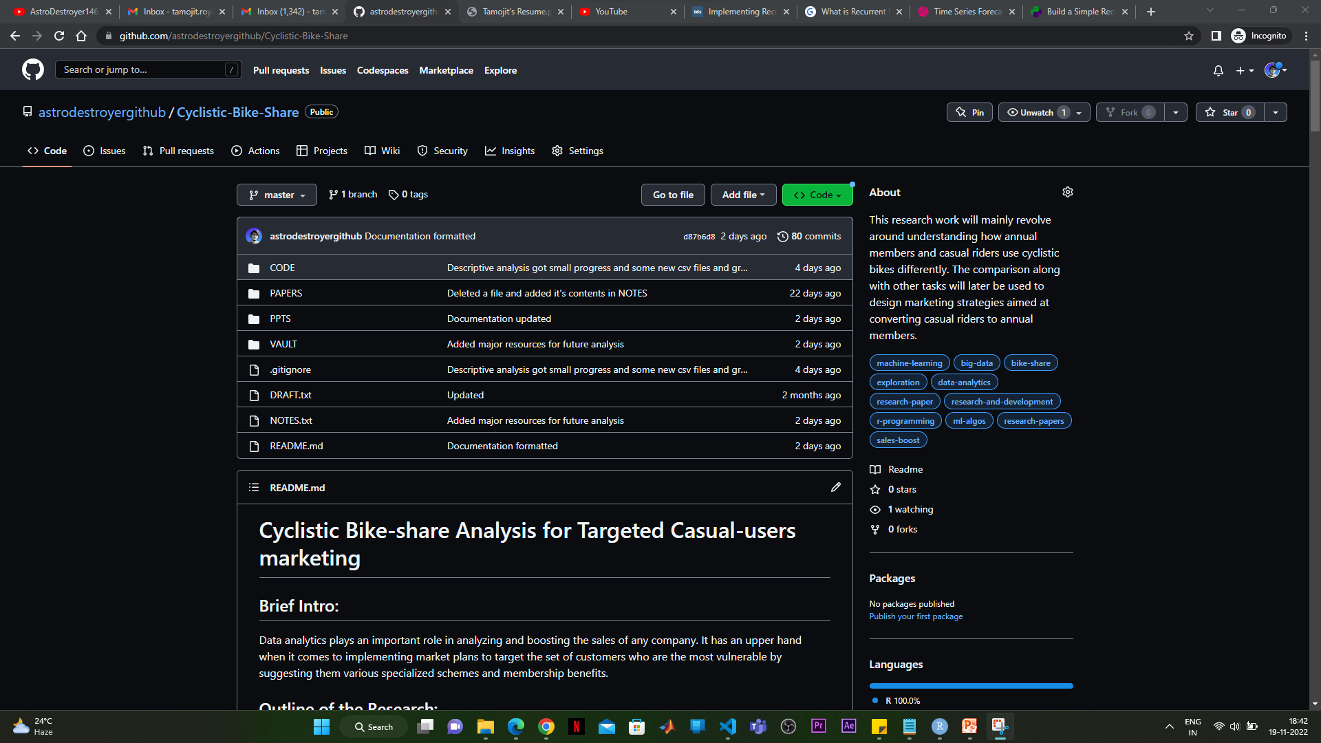
VII. WHAT IS TO BE DONE NEXT

Slide 47
CONTD.
RNN, LSTM, GRU.
Time series forecasting methods (ARIMA, etc.)
More visualizations (using Tableau, etc.)
Other advanced logical techniques to make more sense out of data.
Examining the future scenarios.
More discussions.

Slide 48

VIII. RESEARCH PAPER STATUS
Problem statement specified.
Data to work on found.
Cleaned the data.
Descriptive analysis on data performed.
Visualizations on the basis of analysis obtained.

Slide 49
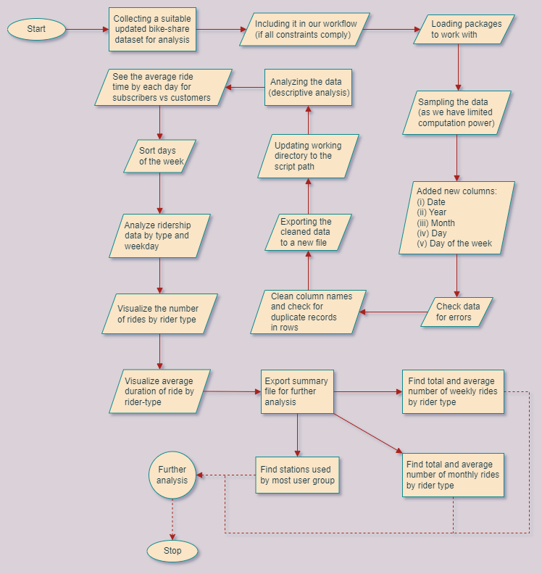

Slide 50
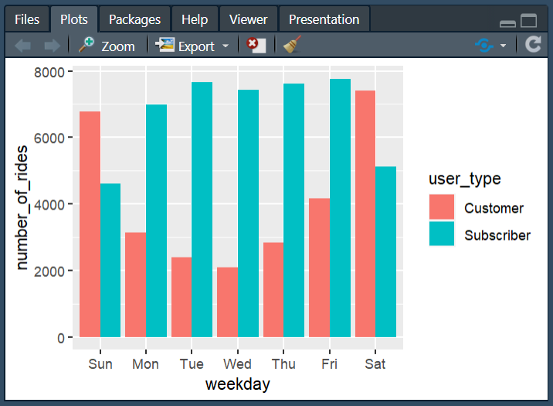
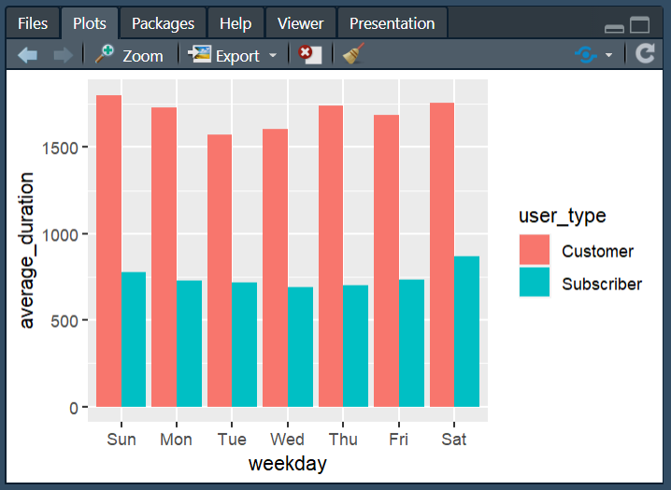
A. Number of rides per user type B. Average trip duration by user type

Slide 51
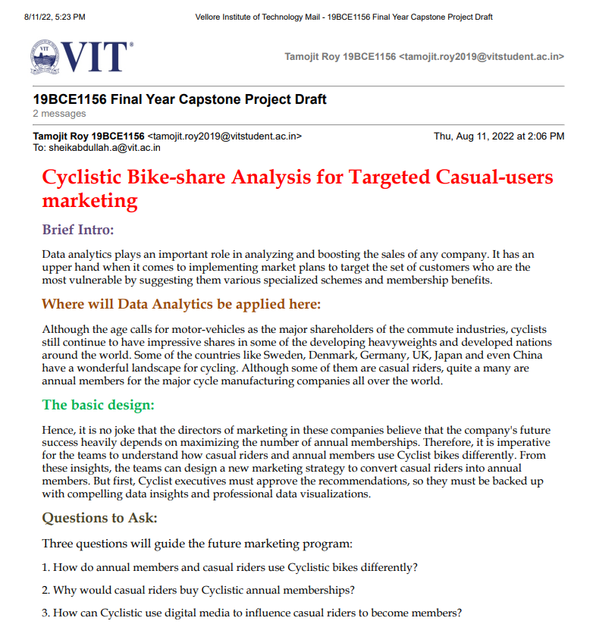
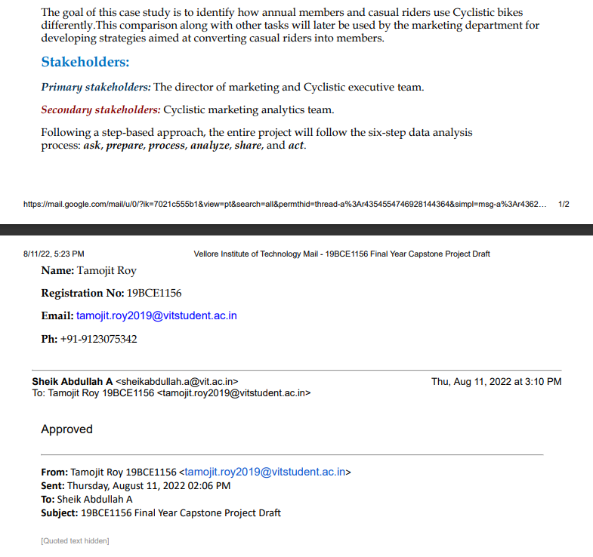
IX. GUIDE APPROVAL MAIL SNAPSHOT

Slide 52
X. REFERENCES
[1] Md Doulotuzzaman Xames, Jannatul Shefa, Ferdous Sarwar, "Bicycle industry as a post‑pandemic green recovery driver in an emerging economy: a SWOT analysis", Springer-Verlag GmbH Germany, part of Springer Nature 2022 (Environmental Science and Pollution Research), July 2022.
[2] Weiwei Jiang, "Bike sharing usage prediction with deep learning: a survey", Springer-Verlag London Ltd., part of Springer Nature 2022, Neural Computing and Applications (2022) 34:15369–15385, June 2022.
[3] Suzana Regina Moro, Paulo Augusto Cauchick-Miguel, "An Analysis of a Bike-Sharing System from a Business Model Perspective", Brazilian Journal of Operations & Production Management, Vol. 19, No. 2, e20221400, 2022, ISSN 2237-8960 (Online), June 2022.
[4] Yuanyuan Guo, Linchuan Yang, Yang Chen, "Bike Share Usage and the Built Environment: A Review", Frontiers in Public Health (www.frontiersin.org), Volume 10, Article 848169, February 2022.

Slide 53
[5] Songhua Hu, Mingyang Chen, Yuan Jiang, Wei Sun, Chenfeng Xiong, "Examining factors associated with bike-and-ride (BnR) activities around metro stations in large-scale dockless bikesharing systems", Journal of Transport Geography 98 (2022) 103271, Elsevier Ltd., December 2021.
[6] Hanning Song, Gaofeng Yin, Xihong Wan, Min Guo, Zhancai Xie, Jiafeng Gu, "Increasing Bike-Sharing Users’ Willingness to Pay — A Study of China Based on Perceived Value Theory and Structural Equation Model", Frontiers in Psychology (www.frontiersin.org), Volume 12 | Article 747462, January 2022.
[7] Xiaonan Zhang, Jianjun Wang, Xueqin Long, Weijia Li, "Understanding the intention to use bike-sharing system: A case study in Xi’an, China", PLoS ONE 16(12): e0258790, December 2021.
[8] Puneeth B. R., Nethravathi P. S., "Bicycle Industry in India and its Challenges – A Case Study", International Journal of Case Studies in Business, IT, and Education (IJCSBE), 5(2), 62-74, ISSN: 2581-6942, Vol. 5, No. 2, August 2021.
[9] Vitória Albuquerque, Miguel Sales Dias, Fernando Bacao, "Machine Learning Approaches to Bike-Sharing Systems: A Systematic Literature Review", International Journal of Geo-Information, ISPRS Int. J. Geo-Inf. 2021, 10, 62, February 2021.

Slide 54
[10] Anil Jain, Nirmala Joshi, Anand J Mayee, "Factors motivating buying behavior of female two wheeler users in the district of Palghar", Journal of Management Research and Analysis, October-December, 2020;7(4):154-158, December 2020.
[11] S. Diwakar Raj, Dr. N. Kannan, "Factors Influencing Purchase of Two Wheeler - A Study with Reference to Chennai City", International Journal of Management, 11(12), 2020, pp 2977-2982, ISSN Print: 0976-6502 and ISSN Online: 0976-6510, December 2020.
[12] Gyugeun Yoon, Joseph Y.J. Chow, "Unlimited-ride bike-share pass pricing revenue management for casual riders using only public data", International Journal of Transportation Science and Technology 9 (2020) 159–169, January 2020.
[13] Leonardo Caggiani, Rosalia Camporeale, Branka Dimitrijević, Milorad Vidović, "An approach to modeling bike-sharing systems based on spatial equity concept", AIIT 2nd International Congress on Transport Infrastructure and Systems in a changing world (TIS ROMA 2019), 23rd-24th September 2019, Rome, Italy, Elsevier B.V., 2020.
[14] Mohammed Hamad Almannaa, "Optimizing Bike Sharing Systems: Dynamic Prediction Using Machine Learning and Statistical Techniques and Rebalancing", DOI: 10.13140/RG.2.2.26034.43202, Thesis for: PhD, Advisor: Hesham Rakha, Project: Bike Research, April 2019.

Slide 55
[15] Elisabete Arsenio, Elisabete Arsenio, Sofia Azeredo Lopes, Helena Iglésias Pereira, "Assessing the market potential of electric bicycles and ICT for low carbon school travel: a case study in the Smart City of ÁGUEDA", European Transport Research Review (2018) 10: 13, Springer, January 2018.
[16] Miriam Ricci, "Bike sharing: A review of evidence on impacts and processes of implementation and operation", Research in Transportation Business & Management 15 (2015) 28–38, Elsevier Ltd., April 2015.
[17] Angela Au, "Social Media Strategies Used in Marketing Custom Bicycle Framebuilding Companies", Doctoral Study - Walden University ScholarWorks (Walden Dissertations and Doctoral Studies Collection), November 2015.
[18] Inês Frade, Anabela Ribeiro, "Bicycle sharing systems demand", EWGT2013 – 16th Meeting of the EURO Working Group on Transportation, Procedia - Social and Behavioral Sciences 111 ( 2014 ) 518 – 527, Elsevier Ltd., February 2014.
[19] Darren Buck, Ralph Buehler, Patricia Happ, Bradley Rawls, Payton Chung, Natalie Borecki, "Are Bikeshare Users Different from Regular Cyclists? A First Look at Short-Term Users, Annual Members, and Area Cyclists in the Washington, DC Region", Transportation Research Record Journal of the Transportation Research Board 2387(-1):112-119, DOI: 10.3141/2387-13, December 2013.

Slide 56
[20] Carlos M. Vallez, Mario Castro, David Contreras, "Challenges and Opportunities in Dock-Based Bike-Sharing Rebalancing: A Systematic Review", Sustainability 2021, 13, 1829. https://doi.org/10.3390/su13041829, MDPI, February 2021.

Slide 57
THANKS!
Any questions?
You can find me at tamojit.roy2019@vitstudent.ac.in

